Slide 1
Pacific Rim Tweets
Rui Song

Slide 2
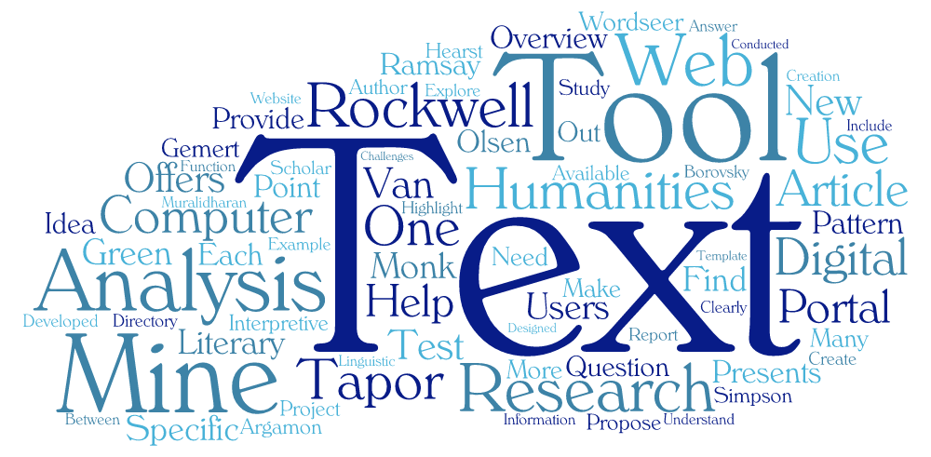
Project Initiative
Many times short
None standard usage of words.
Repetition through retweet.
More subtle than article
Text as an dominant data format on social media carries critical information about people’s opinion, which can be turn into indicator in terms of marketing, etc.

Slide 3

Project Goal
To understand nuances of analyzing tweet data through hashtag Pacific Rim Uprising
Experiment tools to store, understand, present data and analytic result
Tackle the problem of unlabeled data through (Watson NLP & self-built)
Establish end-to-end data analytic project pipeline

Slide 4
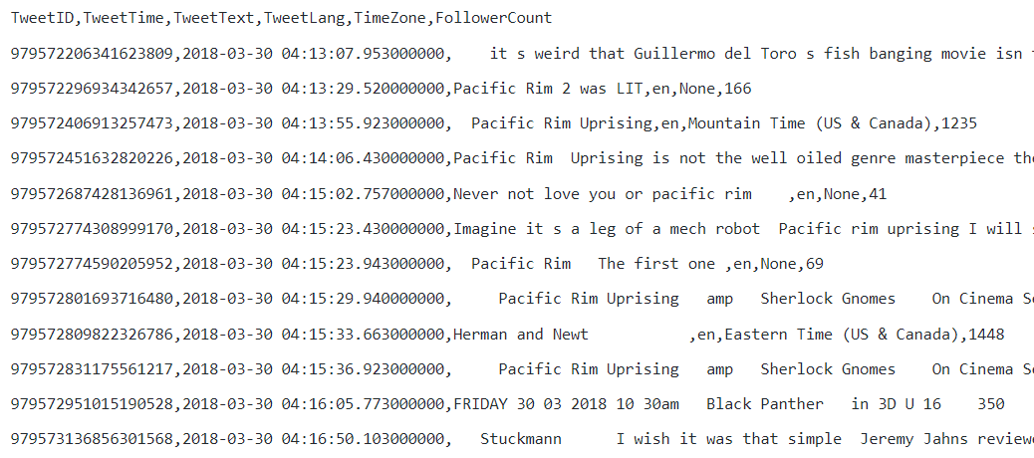
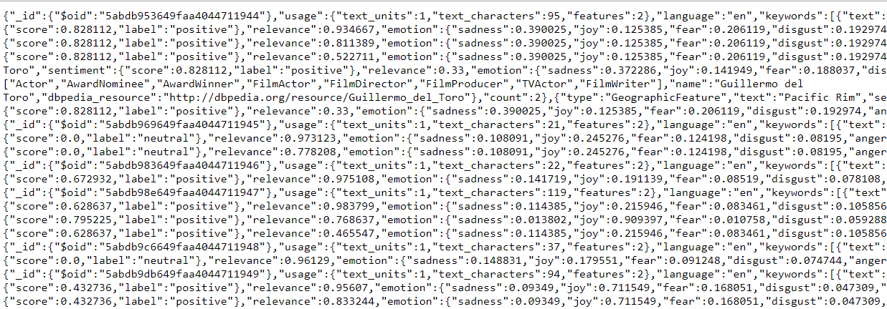
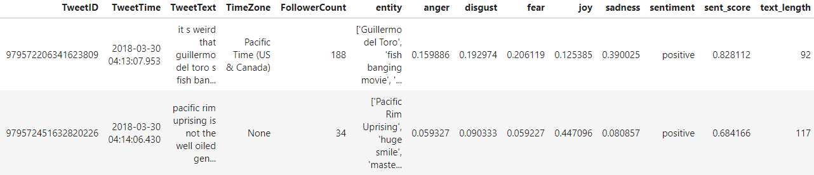
Data Source
Filtered Twitter API Return
Watson NLP API Return

Slide 5
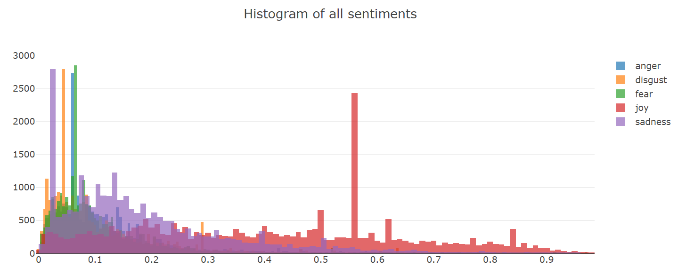
EDA – Emotion score distribution
Spike for all five emotions Watson analysis

Slide 6
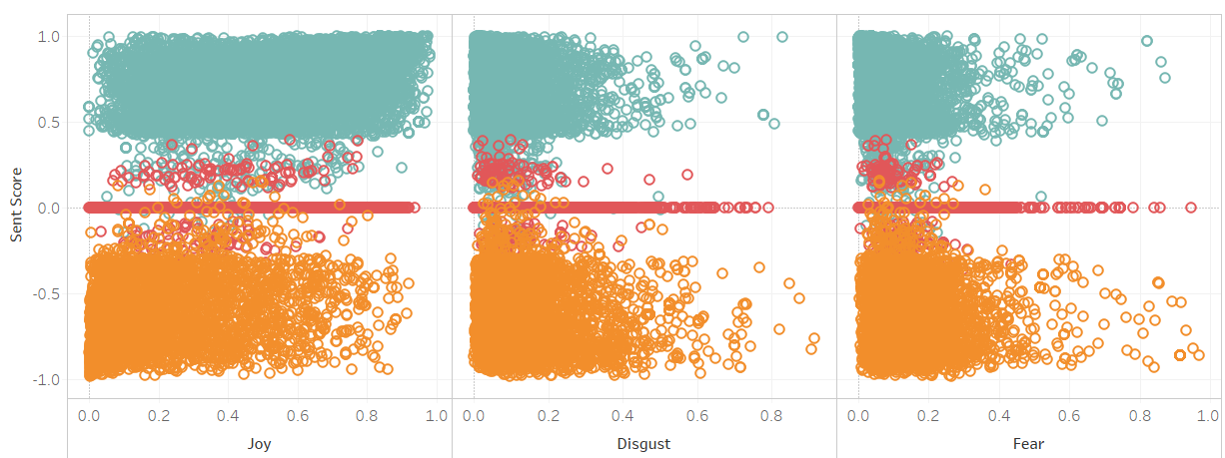
EDA – Sentiment score Versus Emotion
Individual emotion score does not correspond to sentiment score

Slide 7
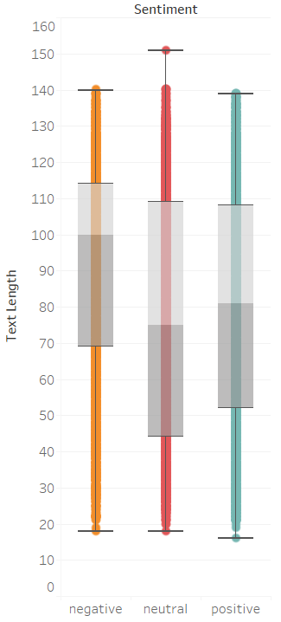
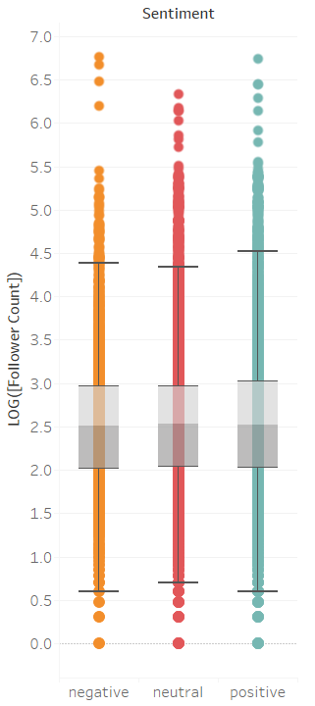
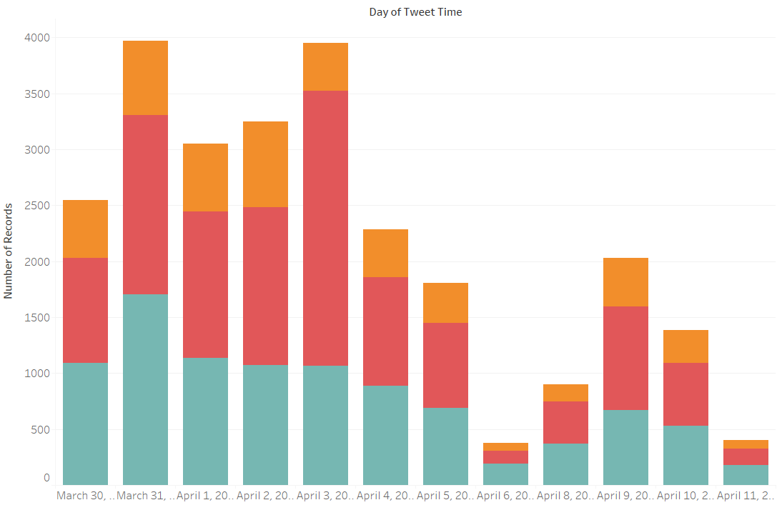

EDA – Against Raw Tweet Data
Tweet Count Daily and proportion of Tweet (System down as quote reached)
Sentiment Versus Text Length & Follower Count

Slide 8
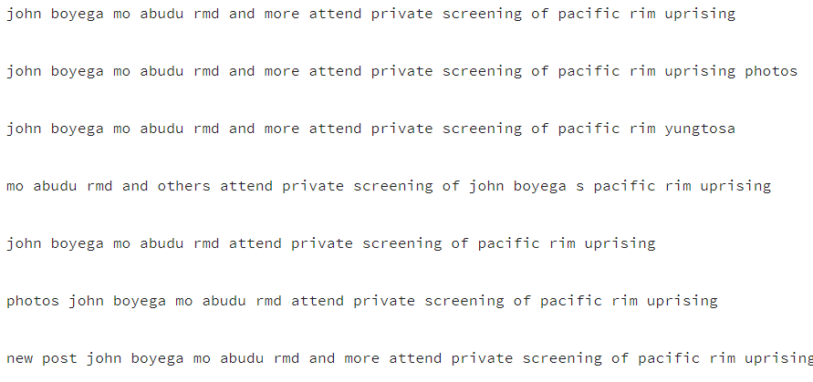
Text Processing – Drop Duplicates
Identical Text (Direct Retweet)
Use df.drop_duplicates(), number drop from 26354 to 15297
Problem – Slightly modified retweet

Slide 9
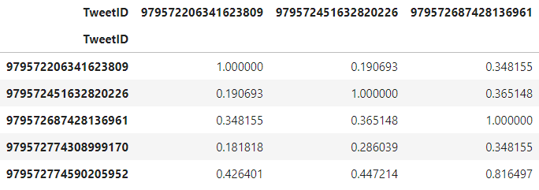
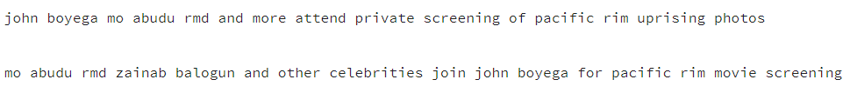
Text Processing – Drop Duplicates
Solving the problem
Use normalized word count vector to represent the similarity between two tweets
def filter_high_sim():
remove_id = set()
n = sim_df.shape[0]
for i in range(n):
if sim_df.index[i] not in remove_id:
for j in range(i+1, n):
if sim_df.index[j] not in remove_id:
if sim_df.iloc[i,j]>=0.8:
remove_id.add(sim_df.index[j])
return remove_id
remove_id = filter_high_sim()
Further removed another 3016 records from the table
Down to only 12240 records

Slide 10
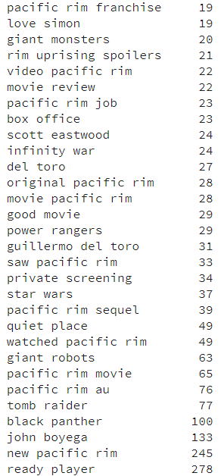
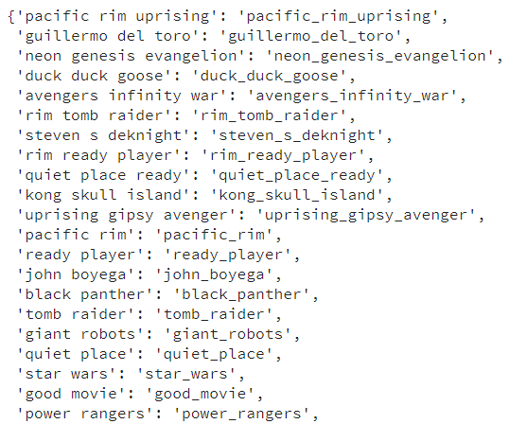
Text Processing – Collocation
Utilize entity recognition feature from Watson NLP to get entities
Filter only entities that appear more than five times.
Sort entities by word count to avoid pacific rim been recognized as pacific_rim uprising instead of pacific_rim_uprising

Slide 11
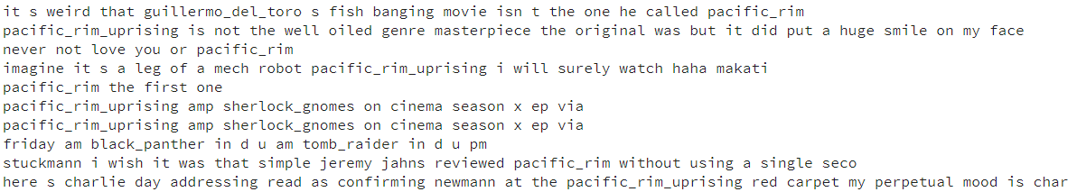
Text Processing – Conclusion
Duplication removal helpful to avoid Model to take the same text multiple times, which poisons performance
Collocation helpful to avoid model consider pacific rim uprising as combination pacific, rim, uprising
Ready for the Modelling stage

Slide 12
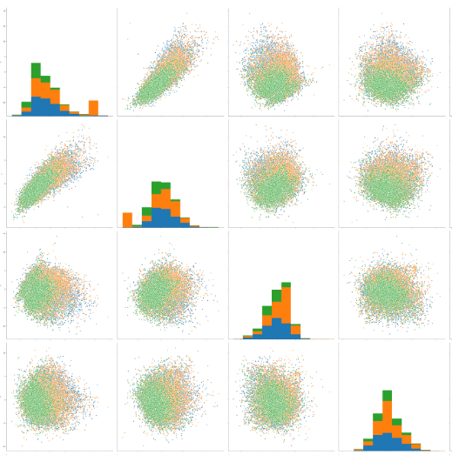
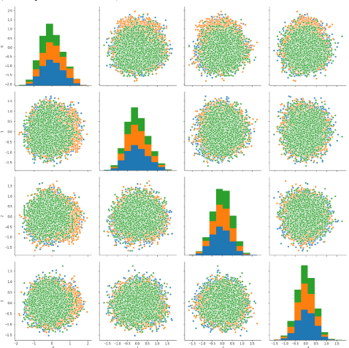
Model – Word Embedding
Stanford Glove Word Average
Doc to Vector Embedding

Slide 13
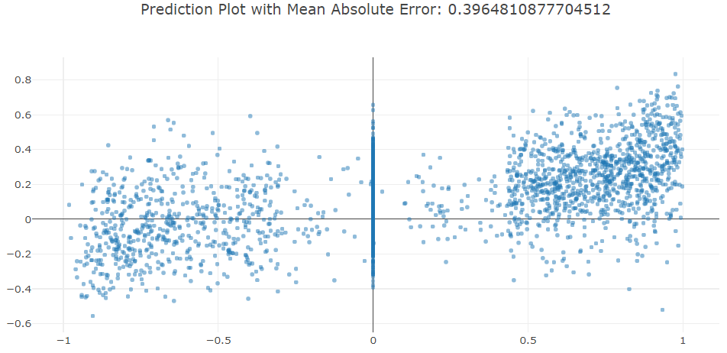
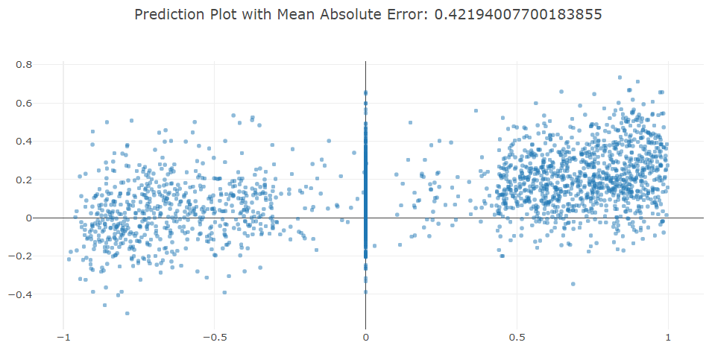
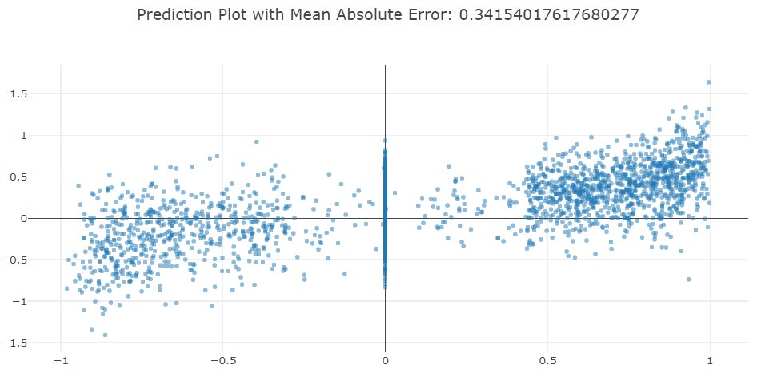
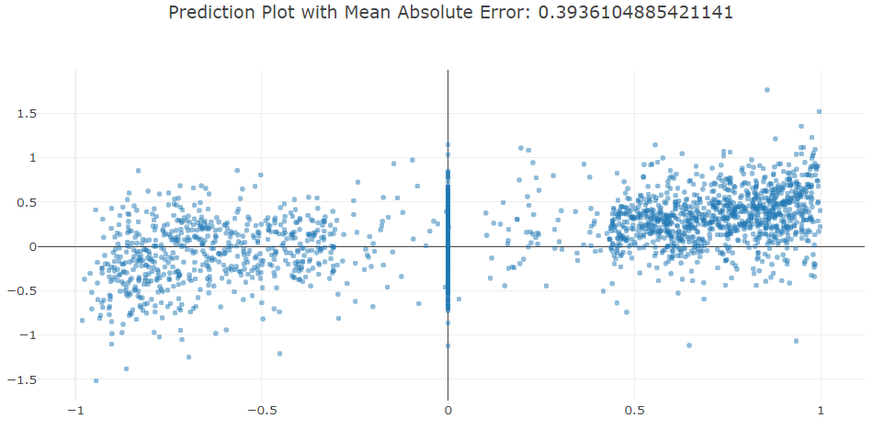
Model – Sentiment Score Regression
Random
Forest (500 trees)
SVM with C=30 RBF
Kernel
Stanford Glove Word Average
Doc to Vector Embedding

Slide 14
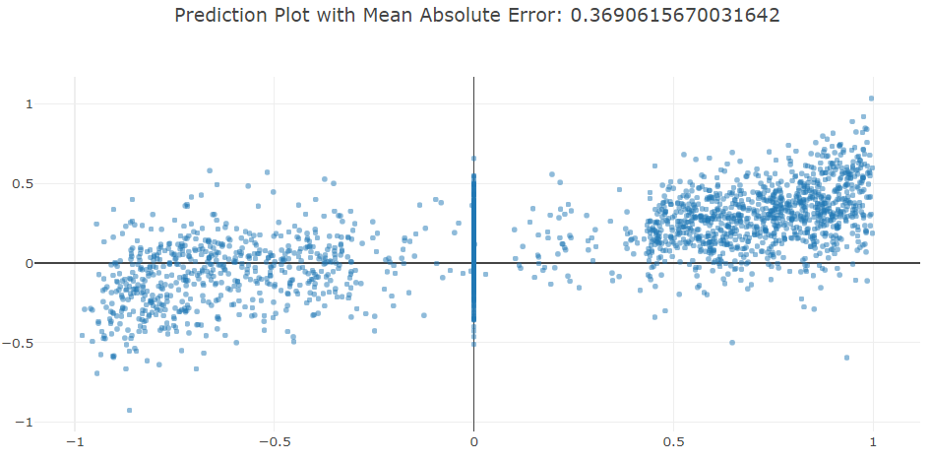
Model – Sentiment Score Regression
Average of all the regression result using model and embedding method. Mean Square value improve further. Comparing to any single mode
With limited sample, Glove embedding out performs custom trained doc2vec embedding.

Slide 15
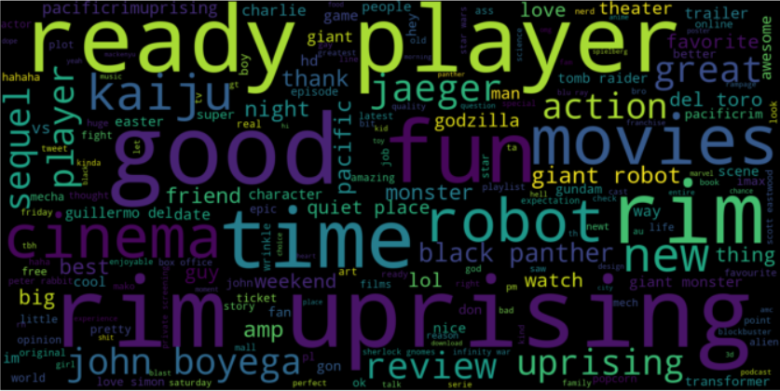
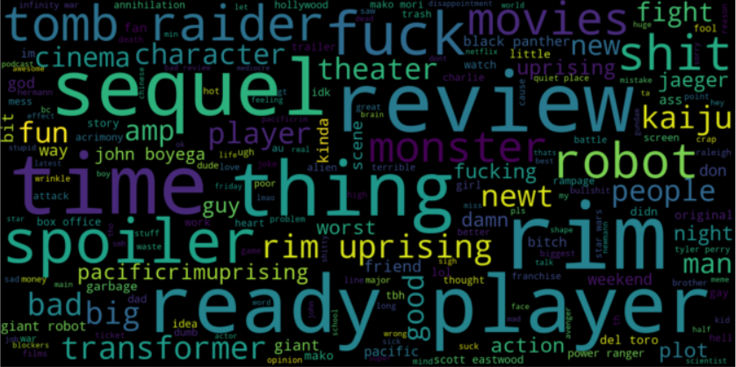
Model - Word Cloud
Positive reviews mostly about robot, movie characters, related sci-fi movies that are of the same time
Bad reviews mostly about comparing the second movie with the first one.
I hated pacific rim uprising so much it s soulless sequel that lacks all of the love and joy the original pacifc

Slide 16
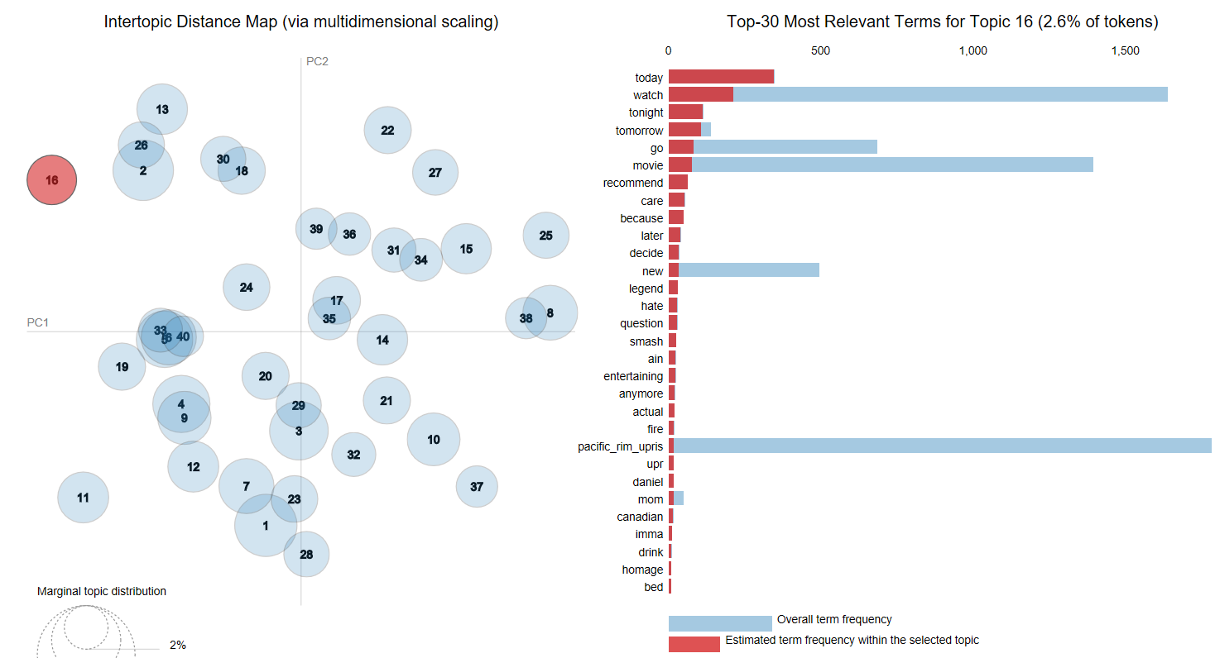
Model – Topic Modelling
Link: LDA Website

Slide 17
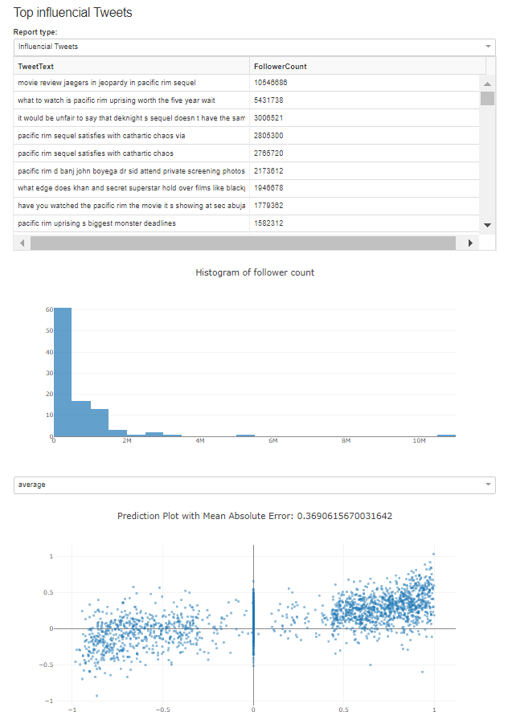
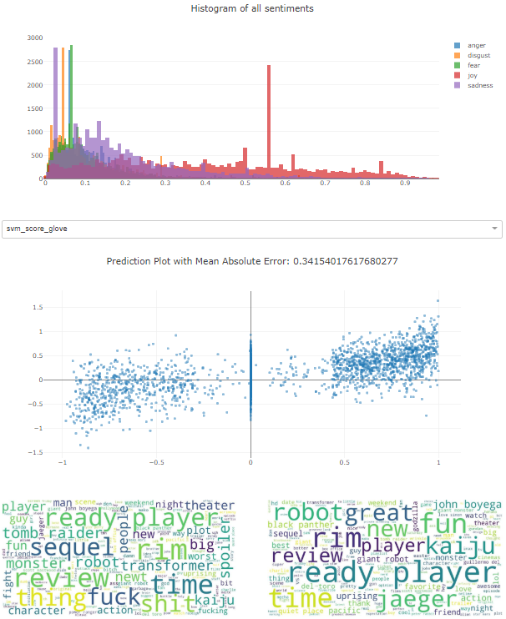
Dash as a flexible Visualization Tool

Slide 18
Project Conclusion
“Your model can only get as good as the data”
When facing small set of text data, pretrained embedding such as Glove out performs self-trained one.
Reliable NLP service from IBM/Google can be a way to tag data
Readily available packages are of great help to develop flexible customized dashboard (embed HTML or Picture)

